Slide 1




NEXT GEN EMPLOYABILITY PROGRAM
Creating a future-ready workforce
Team Members
College Name
Student Name :Devi Varshini B K
Student ID : au960221104049
Xyz

Slide 2

CAPSTONE PROJECT SHOWCASE
Project Title
Car Rentals Application with Django Framework
Abstract | Problem Statement | Project Overview | Proposed Solution | Technology Used | Modelling & Results | Conclusion

Slide 3
Abstract
The goal of this project is to use the high-level Python web framework Django to create an online application for renting cars.
The purpose of the program is to give consumers an easy way to rent cars online.
Users can choose a car to hire by looking through a catalog of available vehicles and viewing data like make, model, and rental cost.
In addition, user authentication features will be integrated into the program, enabling users to register, log in, and oversee their rental reservations.
The program will also have an admin interface for controlling users, cars, and reservations.
The project will effectively create a reliable and user-friendly vehicle rental platform by utilizing Django's built-in technologies, like ORM, templating, and authentication.
Source :

Slide 4
Problem Statement
An effective and user-friendly web application for renting cars needs to be developed using Django.
The goal of this project is to create a web application that offers a simplified online rental automobile platform in order to address these problems.
Customers can register, manage files, and check their rental history using user accounts.
Users can reserve automobiles and manage their appointments using an online booking system.
Processing secure payments for rental costs and possible extras like GPS, insurance, etc.
Source :

Slide 5
Project Overview
The project involves the development of a comprehensive car rental application utilizing the Django,
HTML, CSS, Python, Bootstrap and JavaScript.
The application will provide an easy-to-use interface for both customers and administrators, ensuring a
seamless rental experience.
For customers, the application will provide features such as:
User Registration and Authentication
Account Management
Responsive Design
Secure Authentication
For administrators, the application will provide features such as:
Dashboard
Car Listing Management
User Account Management
Booking Management
Source :

Slide 6
Proposed Solution
.
The suggested solution entails using Django, HTML, CSS, JavaScript, and Bootstrap to construct a web application for automobile rentals.
They may create accounts, modify profiles, and view rental history thanks to the user account capability.
The automobile listings provide information about the models, characteristics, pictures, and availability of the vehicles.
Users can manage their bookings, including cancellations and alterations, through the online booking system.
Users can pay for their rental costs and any extra services like GPS or insurance through the secure payment processing.
Customers may make more educated judgments with the aid of user reviews and ratings.
Source :

Slide 7


Technology Used
Front-end
Back-end
Source :

Slide 8
Modelling & Results
MODELLING:
User Model: Holds user data for authentication and registration.
Car Model: Provides information about each vehicle, including the manufacturer, model, year, cost, and availability.
Booking Model: Provides rental dates and connects consumers with the cars they have reserved RESULTS:
Developed a fully functional car rental web application using Django.
Implemented user authentication, allowing users to register, log in, and manage their bookings.
Created a catalog of available cars with detailed information for users to browse and select.
Implemented a booking system for users to reserve cars for specific rental dates.
Source :

Slide 9
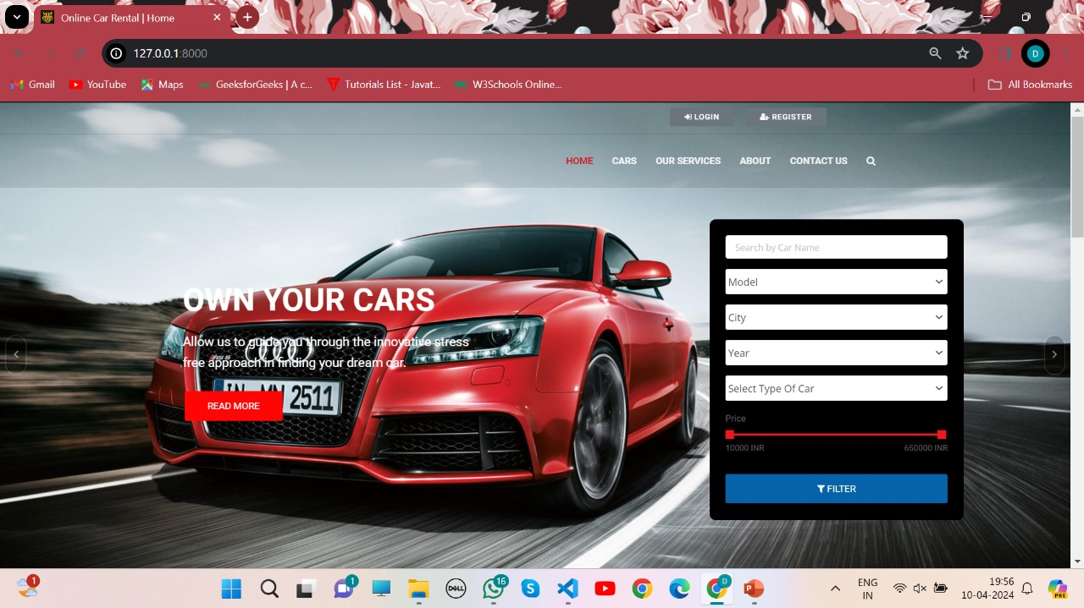
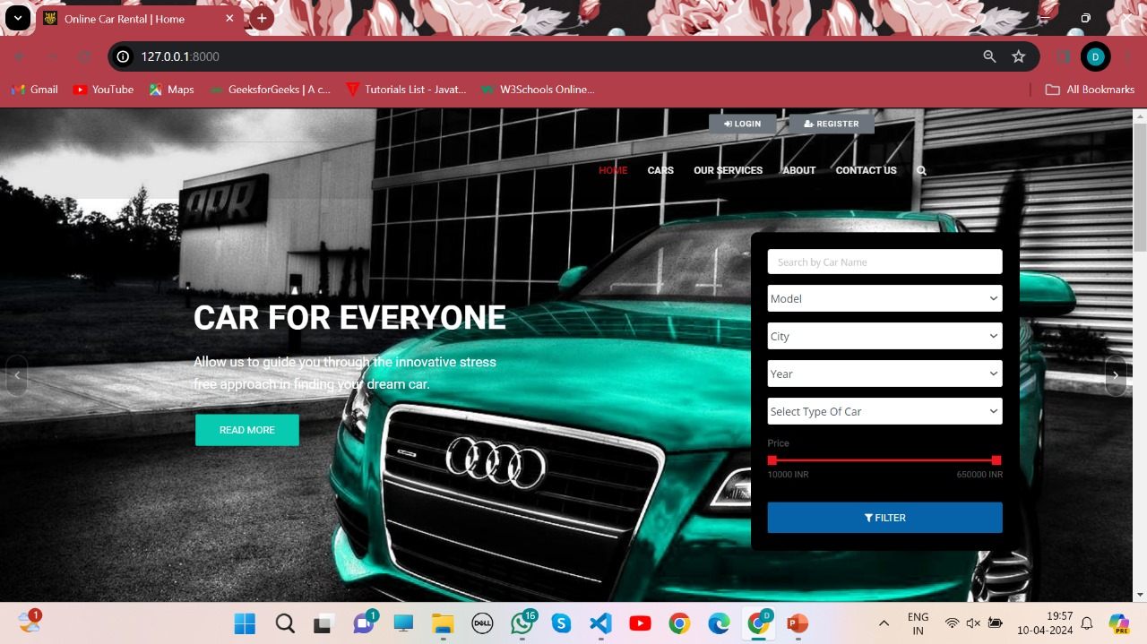
Homepage

Slide 10
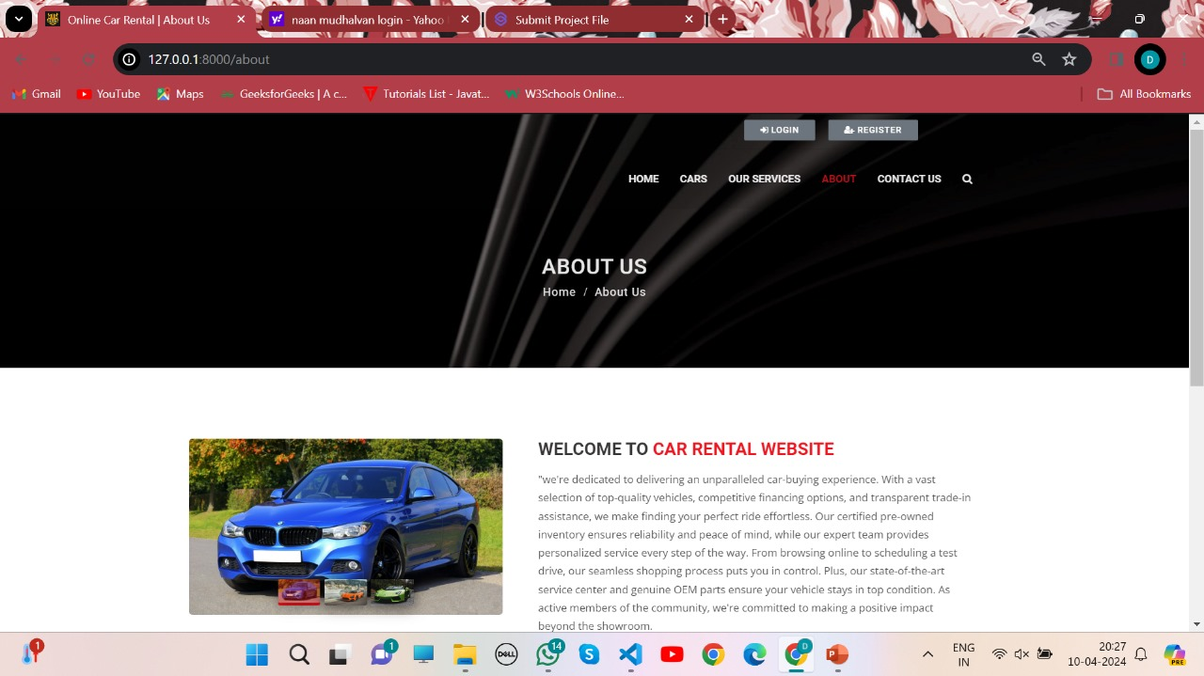
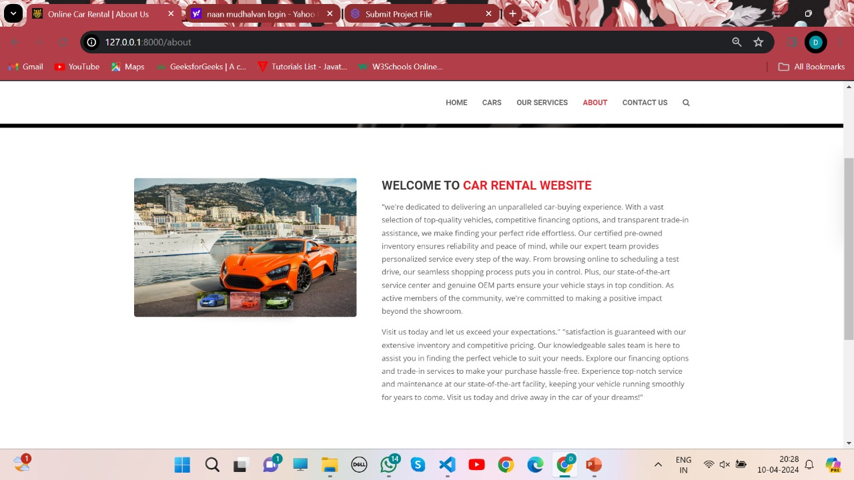
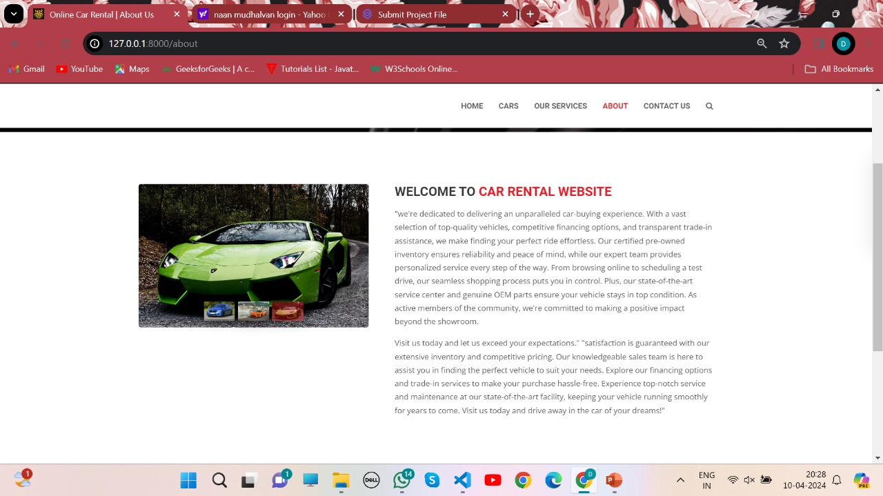
About-Us-Page

Slide 11
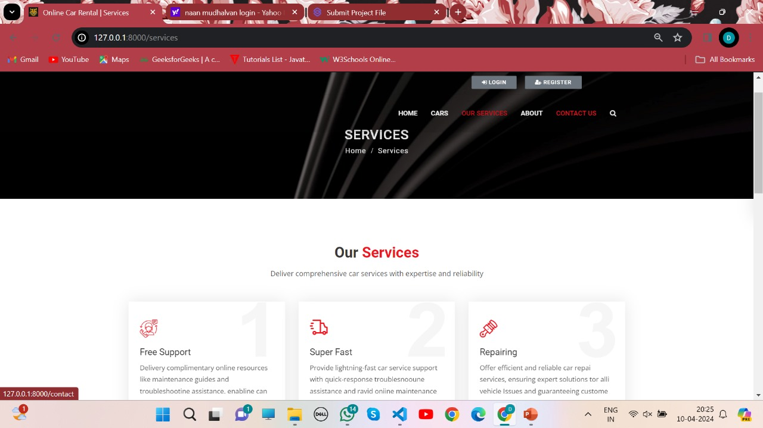
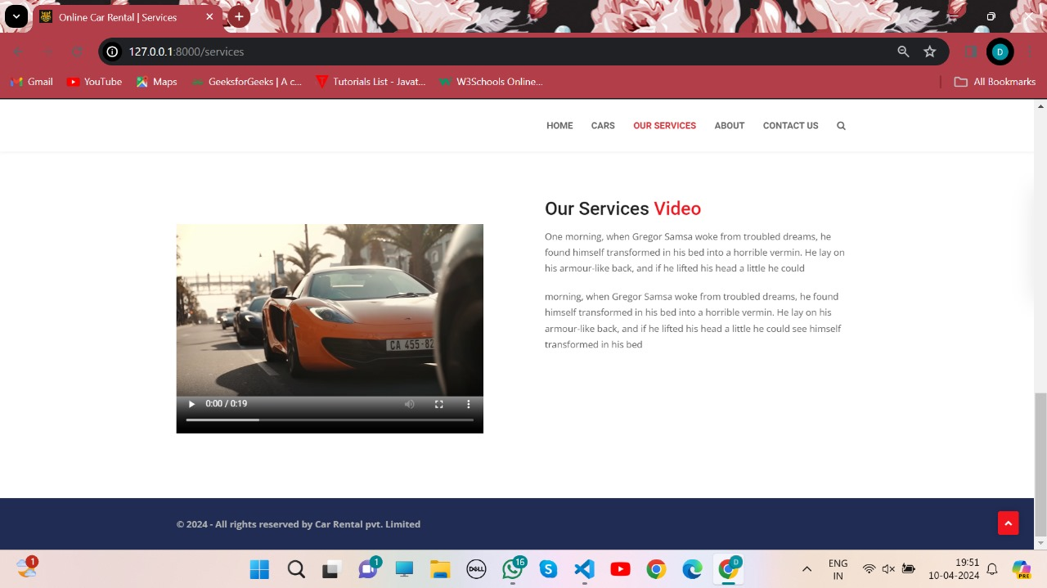
Service-Page

Slide 12
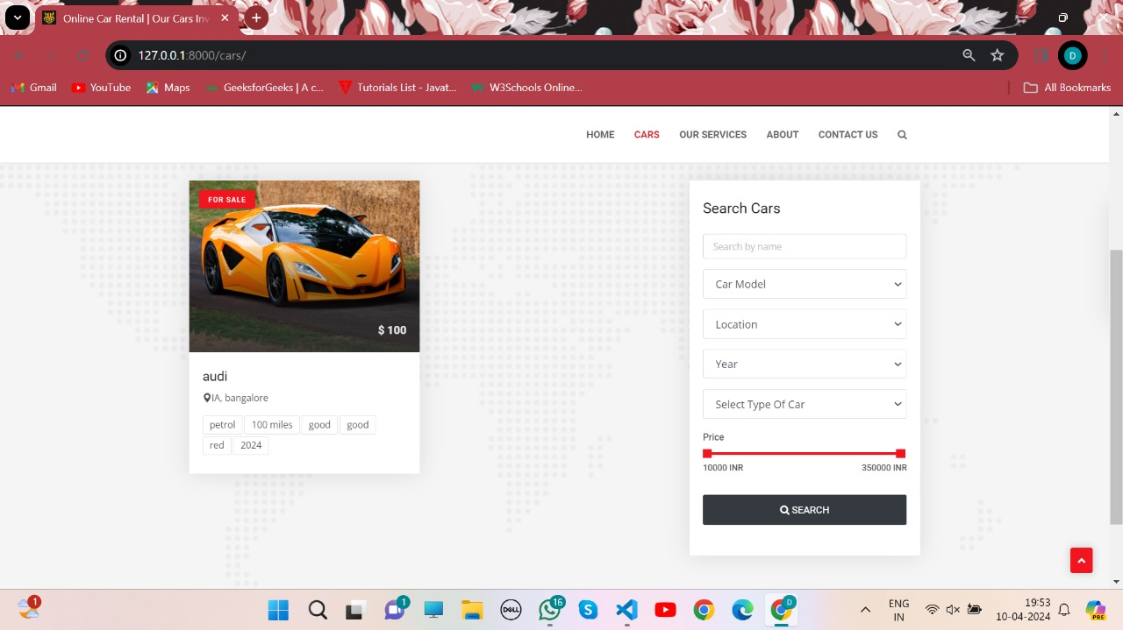
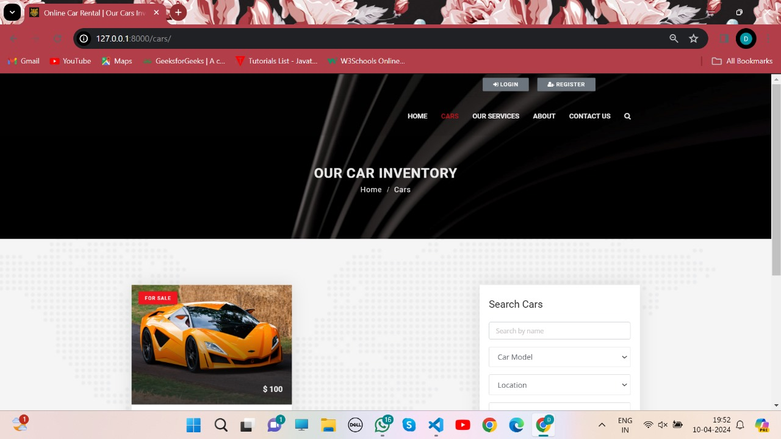
Departments-Page

Slide 13
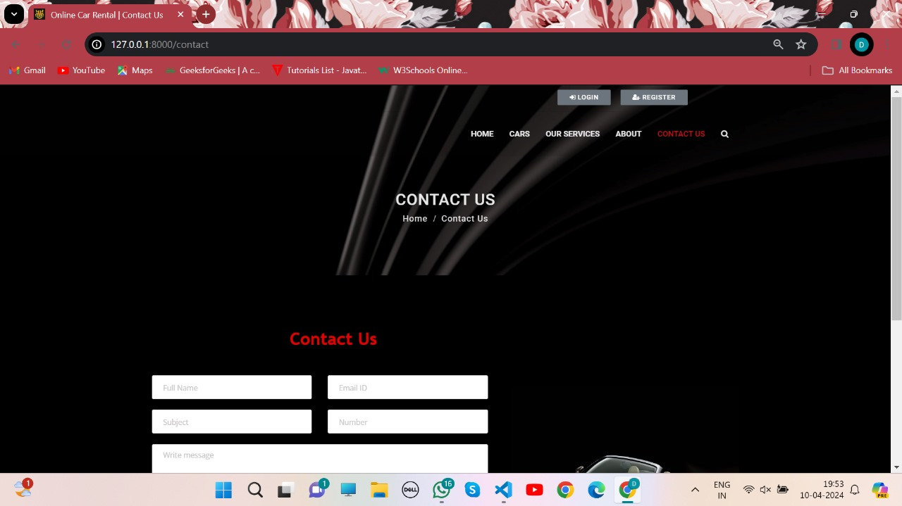
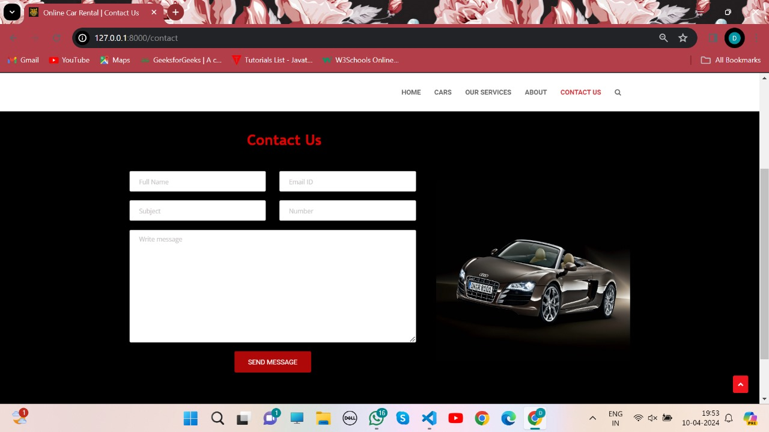
Blog-Page

Slide 14
Future Enhancements:
To increase competitiveness, implement dynamic pricing based on supply, seasonality, and demand.
Enable users to directly arrange maintenance services via the platform, guaranteeing the dependability of their vehicles.
Give users access to real-time traffic and navigation data for easy travel planning.
Give customers the option to rent out their cars to other people, increasing the number of potential renters and income sources.
Incorporate an electric or hybrid car filter to encourage environmentally friendly modes of mobility.
In addition to automobile rental services, provide information on public transportation options to provide complete travel solutions.

Slide 15
Conclusion
Using Django to develop a car rental web application has advantages for rental service companies as well as clients.
The strong structure of Django makes it possible to develop a safe, effective, and user-friendly platform that can improve user experience overall and expedite the renting process.
The program may accommodate a diverse user base by incorporating functionalities like booking systems, automobile listings, admin dashboards, and user authentication.
Future additions to the application, such maintenance scheduling, dynamic pricing, and vehicle monitoring, could improve its usefulness and competitiveness.
Rental service providers may remain ahead of the curve and satisfy their clients' changing expectations by consistently upgrading and improving the application.
Source :

Slide 16
Thank You!
Notes:
Thank You !!

